Slide 1
Lamp Stack
by Russell Powers

Slide 2
ToC
PHP
Fundamentals
Setting UP
Variables
Arrays
Conditionals
Loops
Multidimensional Arrays
Assessments
Advanced
GET & POST
Quiz
Survey Form
Cookie and Session
Headers
Hidden Input
Form Validation
Assenments
PHP with MySql
Inport/Export DB
Connecting
INcluding
DB Communication
MySQL Injection
Encryption
Assenments
MYSQL Queries
Connecting
INSERT
SELECT
UPDATE
DELETE
functions
Joins
Left Join
Export
Asenment (Example Projects)
ERD Lessons
Books
Blogs
User Dashboard
MySQL Queries
MySQl Workbench
MySQLCountries
Sakila
OOP PHP
OOP Fundamentals
Class Structure
Properties
methods
Construct
Assenments
OOP Advanced
Procedural vs OOP
Inheritance
Overwriting
Preserving
Visibility
Protected
Private
Using OOP
Lined List
Assenments
MySQL
ERD Lessions
creating DATA
manipulating DATA
saving data.
View
logic
database
relational database models

Slide 3
ToC
MVC PHP
PHP MVC With Codeigniter
Installation
Controllers
Views/Data
input
Session
Models
Validation
Multiple controllers and models
ORM
PHP MVC With Codeigniter advanced
Form Validations
Client
Client + Controller
Client+Model
Fun w/controllers
More Fun/Controllers
AJAX
Ajax and APi’s
Useful URLs
API
Traversing JSON
Building HTML
Assessments
Ajax api with Jquery and Codeigniter
Ajax
Json
HTML
Create w/o AJax
$.post
Debugging
Importan!
Access Control Origin
Internet is your api
Deployment

Slide 4
MySQL
ERD Lessons
MySQL Queries
Database Relationships
One to One
One to Many
Many to Many
Three (3) Forms of Normalization
MySQL Workbench
Data Types

Slide 5
ERD Lessons
creating, manipulating, and saving data.
View
logic
database
relational database models

Slide 6
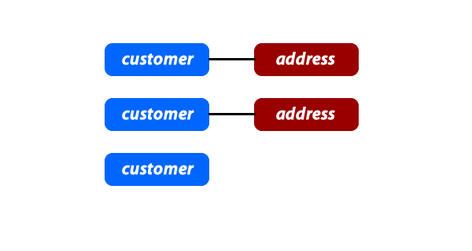
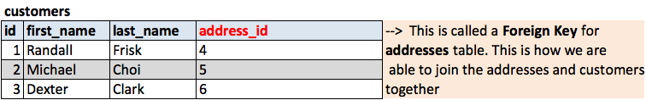

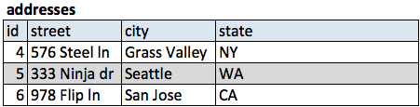
ONe to one Relastionship

Slide 7
What Can We Do with SQL
Even though we split up our tables into two different tables, we can combine them into one using SQL. No need to know how to do this yet, but it is important to see how a table can be joined as long as there is a foreign key that references another table's id. We'll cover actual SQL syntax in the next chapter.
Examples of One-to-One
The easiest way to check to see if your relationship make senses for your data is to simply talk through the relationship out loud. Remember that relationships go in two directions. For example, one address has only one ZIP code, but one ZIP code can have many addresses, thus making it a different type of relationship. Check out some of the sample One-to-One relationships below:
Customers and Credit Cards - Every Customer has one Credit Card, every Credit Card belongs to one Customer.
User and Email - Every User has one Email Address, every Email Address has one User.
Product and Image - Every Product has an Image, every Image is of a Product.

Slide 8
MySQL Queries
Connecting

Slide 9
INSERT

Slide 10
SELECT

Slide 11
UPDATE

Slide 12
DELETE

Slide 13
functions

Slide 14
Joins

Slide 15
Left Join

Slide 16
Export

Slide 17
Asenment (Example Projects)
ERD Lessons
Books
Blogs
User Dashboard
MySQL Queries
MySQl Workbench
MySQLCountries
Sakila

Slide 18
PHP
Fundamentals
Advanced
PHP with MySql

Slide 19
Fundamentals
Setting UP
Variables
Arrays
Conditionals
Loops
Multidimensional Arrays
Assessments

Slide 20
Advanced
GET & POST
Quiz
Survey Form
Cookie and Session
Headers
Hidden Input
Form Validation

Slide 21
PHP with MySql
Inport/Export DB
Connecting
INcluding
DB Communication
MySQL Injection
Encryption
Assenments

Slide 22
OOP PHP
OOP Fundamentals
OOP Advanced

Slide 23
OOP Fundamentals
Class Structure
Properties
methods
Construct
Assenments

Slide 24
OOP Advanced
Procedural vs OOP
Inheritance
Overwriting
Preserving
Visibility
Protected
Private
Using OOP
Lined List
Assenments

Slide 25
MVC PHP
PHP MVC With Codeigniter
PHP MVC With Codeigniter advanced

Slide 26
PHP MVC With Codeigniter
Installation
Controllers
Views/Data
input
Session
Models
Validation
Multiple controllers and models
ORM

Slide 27
PHP MVC With Codeigniter advanced
Form Validations
Client
Client + Controller
Client+Model
Fun w/controllers
More Fun/Controllers

Slide 28
AJAX
Ajax and APi’s
Ajax api with Jquery and Codeigniter

Slide 29
Ajax and APi’s
Useful URLs
API
Traversing JSON
Building HTML
Assessments

Slide 30
Ajax api with Jquery and Codeigniter
Ajax
Json
HTML
Create w/o AJax
$.post
Debugging
Importan!
Access Control Origin
Internet is your api

Slide 31
Deployment

